Slide 1
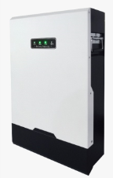
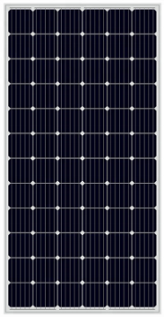
3 KW SOLAR HOME SYSTEM PART LIST & BOM
item | parts | Picture | model | discription | qty | unit price | Amount(USD)
1 | INVERTER |  |  | DC Output：24VDC AC Output: 220V/230V, 50/60Hz,3000W Max Charge Current：80A Size:565*390*190mm | 1
2 | BATTERY |  |  | Rated Voltage：48V(51.2V) Rated Capacity：120AH Capacity: 6KWH (6144WH) Net Weight：55kg DOD depth：100% | 1
3 | SOLAR PANNEL |  |  | Mono Type Vmp:40.15V ; Imp:9.57A; Voca: 49.4V； Isc：10.2A； Rate Power：380W； Size：1979*992*40mm Weight：24.0 kg | 6
4 | PV PANNEL MOUNTING BRACKET |  |  | Pitched Roof | 1
5 | POWER DISTRIBUTION BOX |  |  | Including leakage circuit breaker, 32A 250V air- switch | 1
6 | CABLE |  |  | Solar panel wire Battery wire Inverter wire | 1
7 | PV WATER PROOF CONNECTOR |  |  | Rated Voltage: 1000V DC ●Rated Current: 30A ●IP Rate: IP67 | 1
TOTAL AMOUNT
1. Price Terms: EXW 2. Payment Terms: 100% TT before production less than 10,000USD, bulk order 30% T/T as deposit,the 50% T/T balance before shipment 3.Delivery Time: Estimated 10 working days 4.Actual products and pictures have tolerance for errors 5.Packing: Carton and plywood pallet 6.Weight and dimensions are approximate

Slide 2
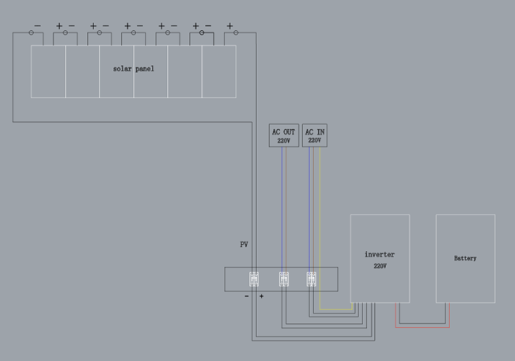
SOLAR SYSTEM CONNECTION DIAGRAM

Slide 3
