Slide 1
high efficiency
hjt module

Slide 2
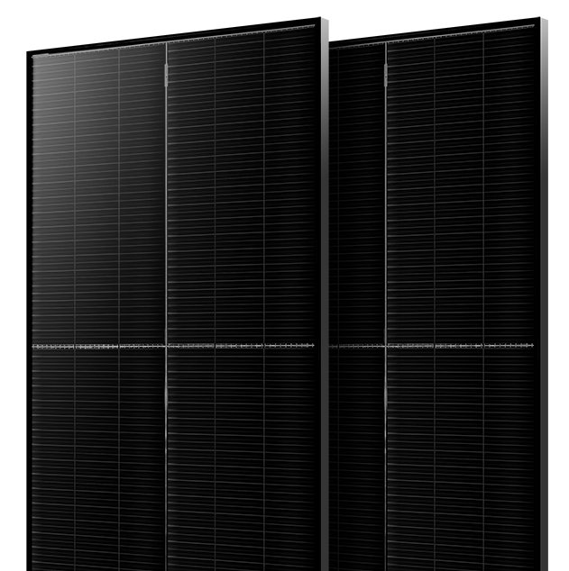

The Power of iPower

Slide 3
HJT Technical Advantage
No PID, LID effect
Lowest Degradation
Higher Energy Production
High Bifaciality
Excellent Low Irradiance Response
Low temperature coefficient
Technical Characteristics of Shingled Module
Higher Reliability
Non-Destructive Cutting Technology
Low-Temperature Welding
Framed Double Glass Design
Mounting System Matching

Slide 4
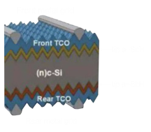
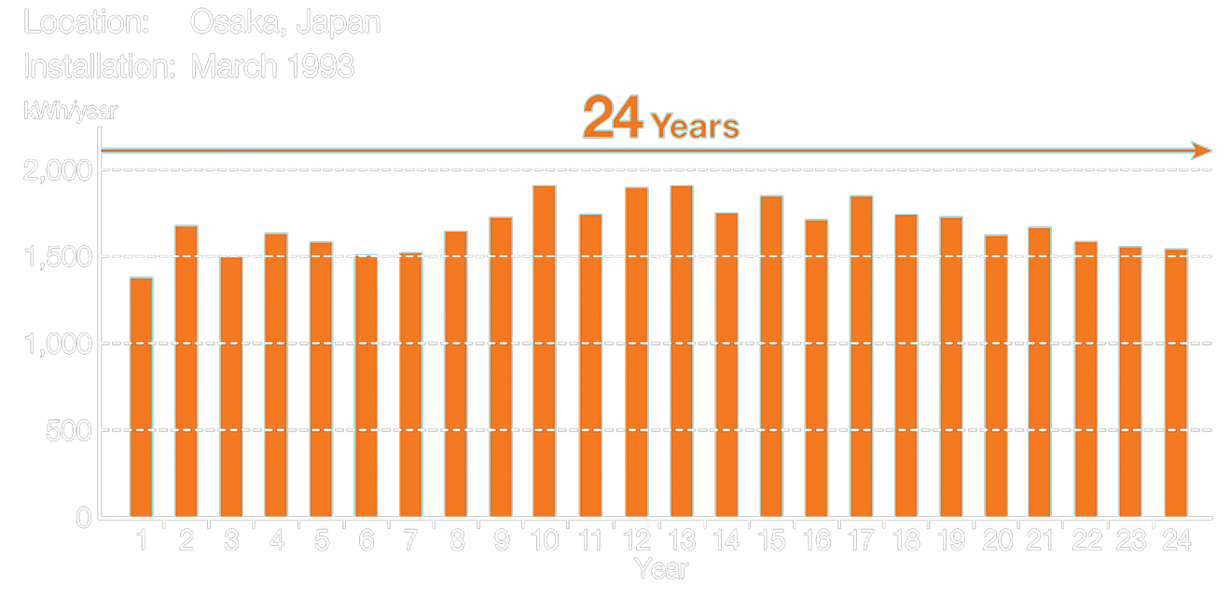
HJT No LID/PID Effect
Note: LID: P-type cells doped with boron and oxygen and metal impurities light irradiation to form compounds, resulting in the cell's efficiency decay;
N-type silicon wafers are mainly doped with phosphorus, which is not easy to form compounds in sunlight.
1、The HJT cell is designed with conductive TCO surface and insulation-free layer, so there is no build-up surface layer charge.
2、25 years of HJT module application with no customer feedback of PID occurrences.
3、No PID occurrences after in-house and third party reliability testing.
Data Source: Panasonic

Slide 5
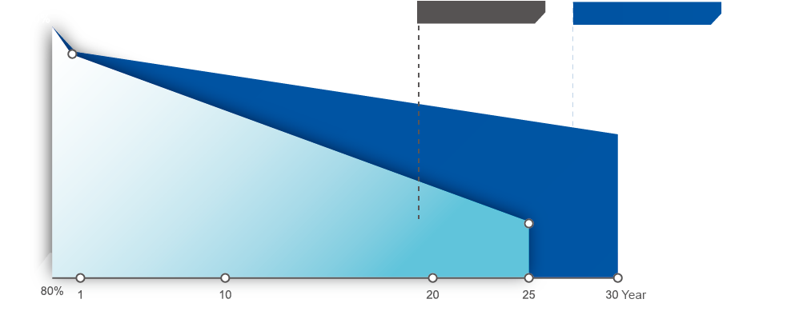
Lowest Degradation
Standard module
HJT shingled module
98%
2%
98%
0.25%/Year
Attenuation rate
in the first year
92%
90.75%
0.55%/Year
-0.25%
84.8%
Linear annual docay
Akcome's laminated module products use HJT cells, which have better attenuation resistance, high efficiency, stable and long-lasting power generation, while Hi-chaser promises to provide the best quality assurance to ensure maximum customer value.
TCO film in HJT module prevents charge accumulation on the surface, resulting high resistance to PID;
LID (light-induced degradation) is mainly formed by B-O complex in silicon wafer. Because of the absence of B-O complex in n-type silicons, the LID effect is less.
Low temperature coefficient and high bifaciality performance allows HJT module to bring more energy yield. According to the existing power warranty curve, HJT module has higher power retention rate than that of Mono PERC. Higher power retention rate brings more energy yields.

Slide 6
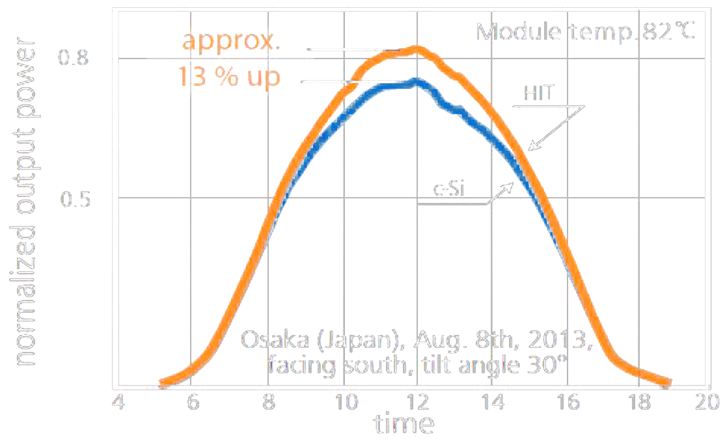
Lower Temperature Coefficients
1.10
1.05
1.00
0.90
0.85
0.80
Data Source: Panasonic
Compared to PERC module, HJT features lower power temperature coefficient and higher output power. It is about 4.9% more efficient in power output than PERC module under 60℃ operation temperature.
HJT demonstrates unique advantages in high temperature/high irradiance area.
Power generation gain of up to 10% or more can be achieved in summer when the module temperature is above 75 degrees.

Slide 7
High Bifaciality
HJT
Cell：MONO-Perc
Type: Mesh-like double glass
Cell：N-TYPE Topcon
Type：Mesh-like double glass
Cell：
Type：Mesh-like double glass
HJT is considered one of the top cell technologies with highest bifaciality. Higher bifaciality allows more energy yield on the back.
Bifaciality：
Bifaciality：
Bifaciality：
65-70%
75-80%
85-90%
Generally, it enables 5%-30% energy gain on the back, depending on the factors such as ground reflection, region type etc.
Note: Bifaciality will be affected by grid width of the back panel, bifaciality of the cell itself and test method etc, which shall be subject to Akcome’s design and test.

Slide 8

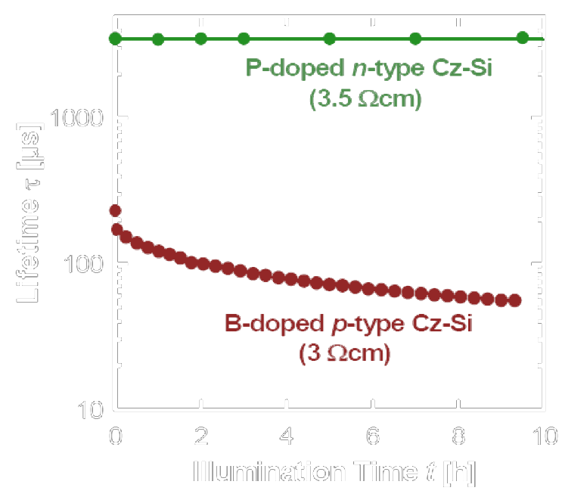
Excellent Low Irradiance Response
Due to the high Minority carriers life time of N-type substrate materials, N-type crystalline silicon modules demonstrate better power generation characteristics than conventional P-type crystalline silicon modules under low light.

Slide 9
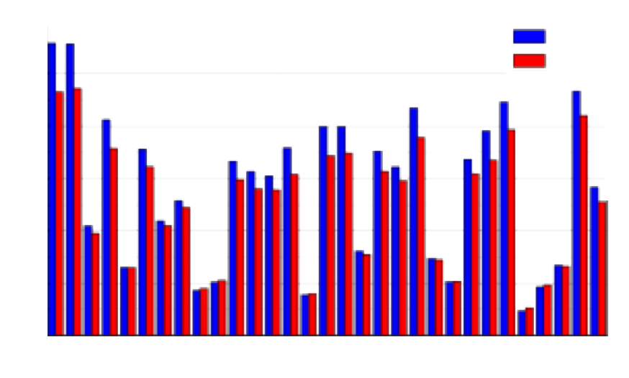
Higher Energy Production
11.07%
The effective power generation time of HJT is 11.07% more than the effective power generation time of conventional cells.

Slide 10
Higher Reliability
All degradation after test is much lower than IEC standard.

Slide 11
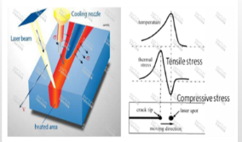

Non-Destructive Cutting Technology
Non-destructive
cutting technology
Non-destructive cutting technology：Laser localized heating and supporting cooling technology are used to form gradient temperature within the material, which formulates the thermal stress to force the material to crack.
Advantages: Smooth surface by non-destructive cutting; no heat affected area; less cutting effect to cell efficiency.
Traditional Cutting
VS
Rough surface resulting 80-120μm heat affected area
Smooth cutting surface with zero heat-affected area
Figure 1: Working principle of non-destructive cutting
166mm Single Glass 9BB Half-Cell （Solar cell：22.5%） | Traditional Cutting | Non-destructive cutting technology
 | 447.17 | 448.59
Increase | 1.4W
Figure 2: Procedures of non-destructive cutting
Figure 3：Comparison of two cutting solutions of 166mm Mono PERC (Data source: Delong)

Slide 12
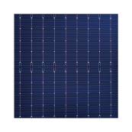
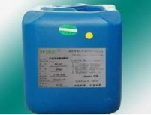
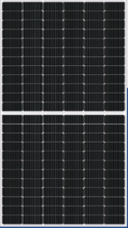
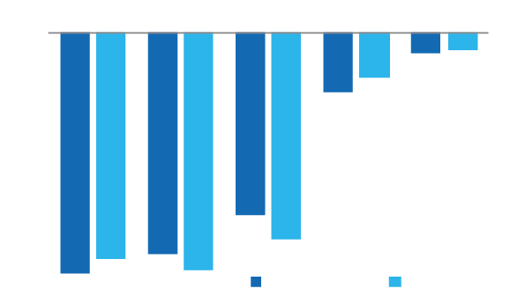

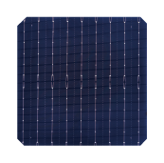

Low-Temperature Welding
Process of HJT Low Temperature Welding VS. PERC cell Traditional Welding
Reliability of HJT low-temperature welding VS. PERC welding
165-190℃
+
Low-temperature welding flux
Welding
HJT Bifacial Double Glass Module
HJT cell
Round wire welding (Tin-Lead-Bismuth)
210-230℃
+
MBB welding flux
HJT cells are welded with low-temperature welding strip and welding flux. Bring much lower damage for the cells.
Welding
Perc Bifacial Double Glass Module
Perc Cell
Round wire welding strip(Tin-Lead)

Slide 13
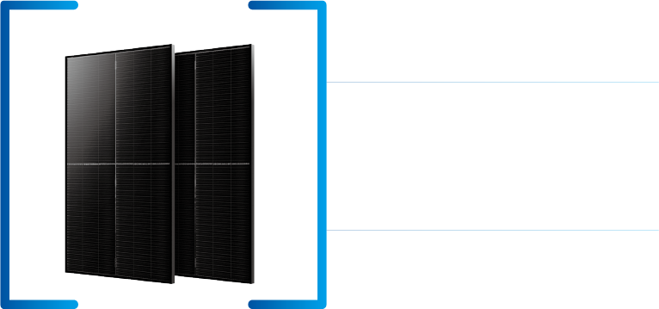
Technical Characteristics of Shingled Module
Akcome's stack welding technology uses the lamination solution after slicing to eliminate the internal cell gap, maximize the light receiving area of the module, and increase the module conversion efficiency by 1% over conventional multi-master grid products.

Slide 14
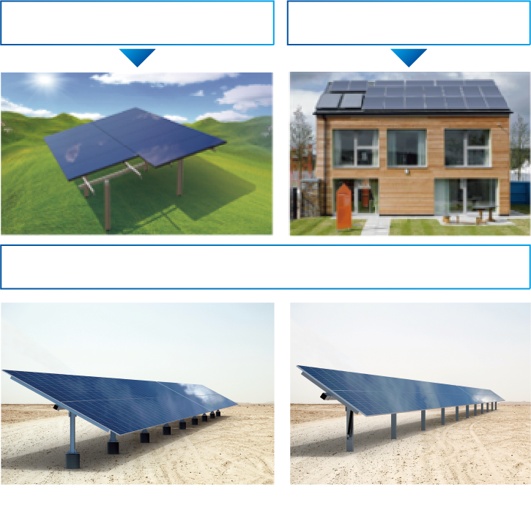
Mounting System Matching
Multiple application
Efficiency improvements help reduce system costs
Full range of mounting system solutions

Slide 15
iPower Product Series
Application Scenario | cell size | Layout | Component size | Weight |  | 2021 Q4 | 2022 Q1 | 2022 Q2 | 2022 Q3 | 2022 Q4
ground power plants | 158.75mm | 60-pattern | 1714*1010*30 | 22.4 |  | 360 | 360 | 365 | 365 | 370
 |  | 72-pattern | 2030*1010*30 | 26.8 |  | 435 | 435 | 440 | 440 | 445
 | 166mm | 60-pattern | 1755*1038*30 | 22.8 |  | 395 | 395 | 400 | 400 | 405
 |  | 72-pattern | 2094*1038*30 | 27.0 |  | 475 | 475 | 480 | 480 | 485
 | 210mm | 50-pattern | 2187*1102*35 | 30.3 |  |  | 525 | 525 | 530 | 530
 |  | 55-pattern | 2384*1096*35 | 32.6 |  |  | 575 | 575 | 580 | 580
 |  | 60-pattern | 2172*1303*35 | 35.3 |  |  | 625 | 625 | 630 | 630
 |  | 66-pattern | 2384*1303*35 | 38.7 |  |  | 685 | 685 | 690 | 690
distributed power plants | 210mm | 40-pattern | 1754*1096*30 |  | 23.6 |  | 420 | 420 | 425 | 425

Slide 16



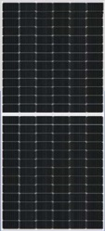
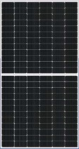
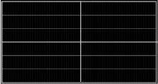
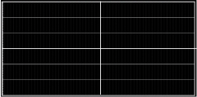
2021主推版型
72-Pattern
158.75mm
72-Pattern
166mm
55-Pattern
210mm
66-Pattern
210mm
Maximum Power Pmax (W)
Power Tolerance(%)
Maximum Power Voltage Vmp(V)
Maximum Power Current Imp(A)
Open Circuit Voltage Voc(V)
Short Circuit Current Isc(A)
module efficiency(%)
module size(mm)
430W
0~+3%
45.46
9.46
54.00
10.08
20.98
2030*1010*30
470W
0~+3%
45.70
10.28
53.95
11.02
21.62
2094*1038*30
575W
0~+3%
35.45
16.22
41.33
17.22
22.00
2384*1096*35
685W
0~+3%
43.32
16.19
49.40
17.20
22.10
2384*1303*35
Temperature Coefficients of PmpTemperature Coefficients of Voc
Temperature Coefficients of Isc
-0.24%/℃
-0.22%/℃ +0.047%/℃
-0.24%/℃
-0.22%/℃ +0.047%/℃
-0.24%/℃
-0.22%/℃ +0.047%/℃
-0.24%/℃
-0.21%/℃ +0.047%/℃
*STC(Standard Test Condition): Irradiance 1000w/m2, Cell Temperature 25℃, Air Mass1.5

Slide 17
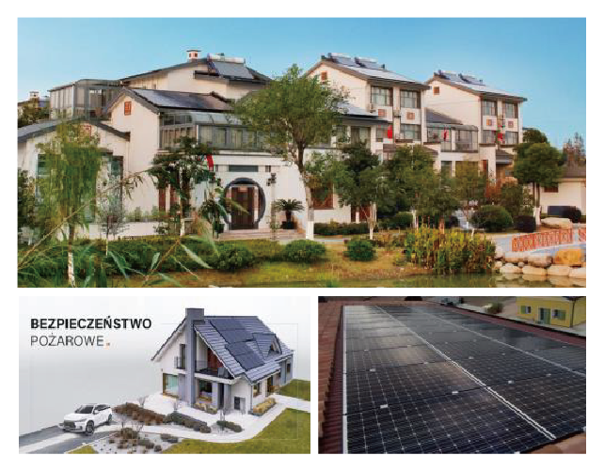
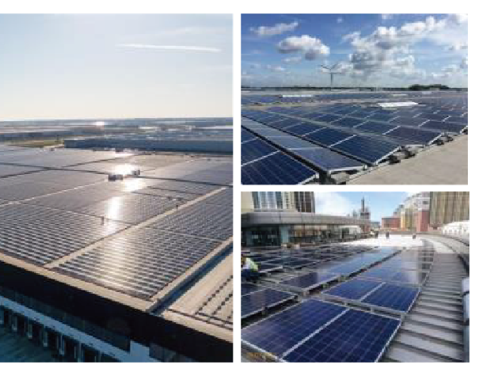
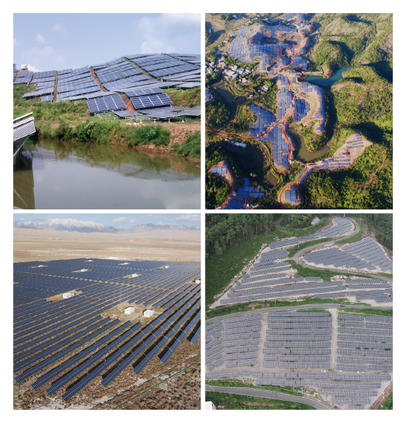
Configuration version
Residential
Commercial
Utility
iPower 390/395/400
iPower 430/435/440
iPower 570/575/580
iPower 415/420/425
iPower 470/475/480
iPower 620/625/630
iPower 520/525/530
iPower 680/685/690

Slide 18




Benchmarking Module Details
Higher module efficiency
Cell size/Layout | 166mm /120pcs |  | 210mm /132pcs |  | 158.75mm/ 132pcs | 210mm/ 120pcs
Module | Akcome HJT Half-cut | L Brand Perc Half-cut | Akcome HJT Half-cut | T Brand Perc Half-cut | Akcome HJT shingled all black | T Brand Perc Half-cut
Power（W） | 395 | 375 | 700 | 670 | 425 | 415
Size (Length*width* Height/mm) | 1791*1048*30 | 1755*1038*35 | 2384*1303*35 | 2384*1303*35 | 1690*1160*30 | 1754*1096*30
Efficiency(%） | 21.04% | 20.59% | 22.53% | 21.57% | 21.68% | 20.42%
Bifaciality Factor(%) | 85% | / | 85% | 70% | 85% | /
Degradation Rate(%） | 2% for the first year, and 0.25% annually since the 2nd year | 2% for the first year, and 0.55% annually since the 2nd year | 2% for the first year, and 0.25% annually since the 2nd year | 2% for the first year, and 0.55% annually since the 2nd year | 2% for the first year, and 0.25% annually since the 2nd year | 2% for the first year, and 0.55% annually since the 2nd year
Temperature Coefficients(%/℃) | -0.24% | -0.35% | -0.24% | -0.34% | -0.24% | -0.34%
Higher generation revenue
Compatible with distributed
power system on rooftops and large-scale ground-mounted power plants
Lower Full life cycle cost of electricity

Slide 19
Application Scenario Analysis②-Ground Power Plant
BOS cost analysis Fixed adjustable mounting system , longitudinal double row 2P,30% sand reflectivity Extremely low Environmental Temperature -22℃
Cell size/Layout |  | 166mm /120pcs |  | 210mm /132pcs
Module |  | Akcome HJT Half-cut | L Brand Perc Half-cut | Akcome HJT Half-cut | T Brand Perc Half-cut
Power（W） |  | 395 | 375 | 700 | 670
Efficiency（%） |  | 21.04% | 20.59% | 22.53% | 21.57%
Power generation | 30-year power generation with the same area | 54.3 | 49.7 | 54.0 | 50.9
 | 30-year cumulative increase rate | 9.20% | benchmark | 6.10% | benchmark
BOS cost | Land cost | -6.00% | benchmark | -4.30% | benchmark
 | Variable BOS cost | 1.70% | benchmark | -2.10% | benchmark
LCOE | LCOE | 0.2882 | 0.3013 | 0.2841 | 0.2929
 | LCOE calculation | -4.50% | benchmark | -3.10% | benchmark
Ulan，Qinghai，China
100000㎡(250*400m)Fixed area
Adopts Akcome Fixed Mounting System
Improved energy yield for 30 years：
Land cost saving：
Variable BOS cost：
LCOE reduce：
+9.20%
-6.00%
+1.70%
-4.50%

Slide 20
Application Scenario Analysis①-Ground Power Plant
BOS cost analysis Fixed adjustable mounting system , longitudinal double row 2P,30% sand reflectivity， Extremely low Environmental Temperature 9℃
Cell size/Layout |  | 166mm /120pcs |  | 210mm /132pcs
Module |  | Akcome HJT Half-cut | L Brand Perc Half-cut | Akcome HJT Half-cut | T Brand Perc Half-cut
Power（W） |  | 395 | 375 | 700 | 670
conversion efficiency（%） |  | 21.04% | 20.59% | 22.53% | 21.57%
Power generation | 30-year power generation with the same area | 52.2 | 47 | 51.5 | 47.7
 | 30-year cumulative increase rate | 11.10% | benchmark | 8.10% | Benchmark
BOS cost | Land cost | -6.00% | benchmark | -4.30% | Benchmark
 | Variable BOS cost | 4.5% | benchmark | -2.2% | benchmark
LCOE | LCOE | 0.2933 | 0.3097 | 0.2921 | 0.3051
 | LCOE calculation | -5.6% | benchmark | -4.5% | benchmark
Abu Dhabi，Middle East
100000㎡(250*400m)Fixed area
Adopts Akcome Fixed Mounting System
Improved energy yield for 30 years：
Land cost saving：
Variable BOS cost：
LCOE reduce：
+11.10%
-6.00%
+4.50%
-5.60%

Slide 21
Application Scenario Analysis③-Roof Power Plant
Zhangjiagang，Jiangsu，China
BOS cost analysis Fixed adjustable roof mounting system , longitudinal double row 2P,70% sand reflectivity Extremely low Environmental Temperature -5℃
Module | I POWER HJT Half-cut | L Brand Perc Half-cut | I POWER HJT shingled all black | T Brand Perc Half-cut
Cell size/Layout | 166mm/120pcs | 166mm/120pcs | 158.75mm/132pcs | 210mm/120pcs
Power（W） | 395 | 375 | 425 | 415
Efficiency（%） | 21.04% | 20.59% | 21.68% | 20.42%
30-year power generation with the same area | 4.5 | 4.1 | 4.5 | 3.9
30-year cumulative increase rate | 9.40% | benchmark | 14.50% | benchmark
Roof cost | 4.1736 | 3.957 | 4.1374 | 3.8591
LCOE | 0.4173 | 0.4427 | 0.4166 | 0.4391
LCOE calculation | -6.10% | benchmark | -5.40% | benchmark
10000㎡(100*100m) Fixed area，Industrial and commercial roof
Adopts Akcome Fixed Mounting System
Improved energy yield for 30 years：
LCOE reduce：
+14.50%
-6.10%

Slide 22
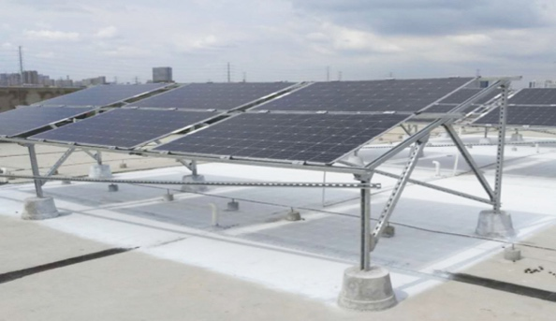
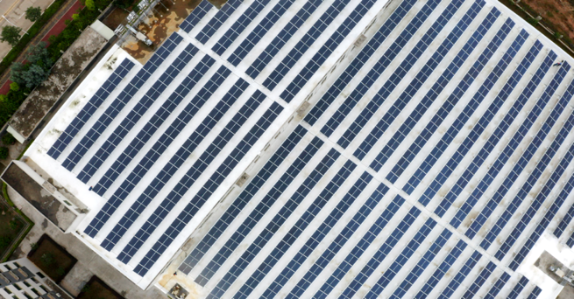
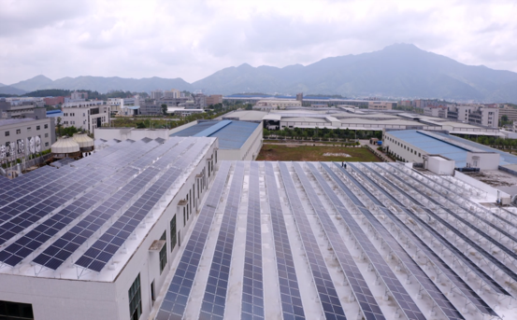
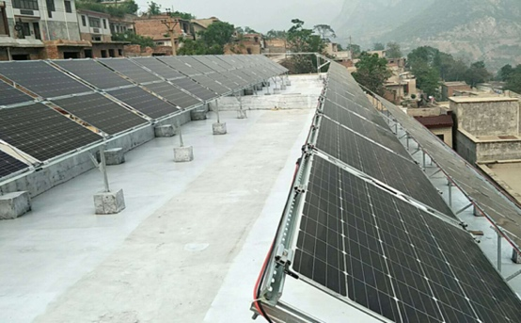
HJT Project Case
Photovoltaic Poverty Alleviation (PVPA) project -- Longchuan County 5.19MW
industrial and commercial DPV project -- Taixing Industrial Park 1MW
Residential DPV project -- Handan, Hebei 30kW

Slide 23
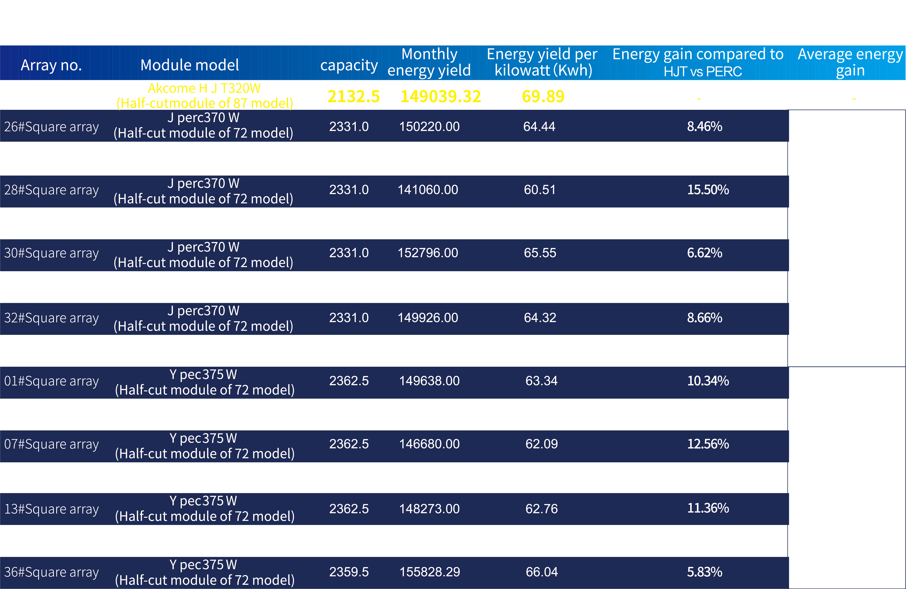
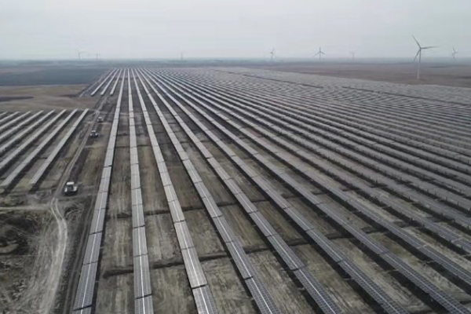
Real Data of HJT Module Application
4.26 MW HJT PV Project,
Power Generation Application Leading Base –
Baicheng, Jilin

Slide 24

Web: www.ipss.co.kr
Korea distributor : ips system co,.ltd
Partner :

